Slide 1
M.Tech Project Report | Department of Mechanical Engineering | 2026
Plasticity Modelling Using
Drucker–Prager Criterion
Under Plane Stress Condition
Using UMAT in Abaqus
Submitted by: Rajkumar Singh
Submitted to: Dr. Mayank Chauksy
ME666 | M.Tech Mechanical Engineering
Rajkumar Singh | ME666 | Department of Mechanical Engineering

Slide 2
Abstract
2
A pressure-dependent plasticity model based on the Drucker–Prager yield criterion is implemented in Abaqus using a User Material subroutine (UMAT) written in FORTRAN.
Plane stress conditions are enforced (σzz = 0), suitable for thin structural components.
An elastic predictor – plastic corrector return-mapping algorithm is developed for numerical integration of constitutive equations.
Newton–Raphson iteration is employed to satisfy the consistency condition (f = 0) at each load step.
The consistent algorithmic tangent stiffness matrix (DDSDDE) is derived and coded to ensure quadratic convergence.
Results are validated against Abaqus built-in Drucker–Prager model showing excellent agreement.
Drucker–Prager Yield Surface
σ₁=σ₂=σ₃ (Hydrostatic axis)
Yield
Surface
f = αI₁ + √J₂ − k = 0
Yield criterion expressed in stress invariants
Rajkumar Singh | ME666 | Department of Mechanical Engineering

Slide 3
Motivation and Need of Plasticity Modelling
3
Why Plasticity?
Key Engineering Challenges
Linear elastic models fail to capture permanent deformations and post-yield material behaviour.
Nonlinear FEM demands accurate constitutive models to predict stress redistribution and collapse loads.
Pressure-dependent materials (soils, rocks, concrete, polymers) require yield criteria beyond von Mises.
Custom UMAT enables research-grade control over material formulations not available in standard libraries.
Complex stress paths in real structures
Anisotropic / heterogeneous materials
Large plastic deformation zones
Multi-physics coupling requirements
Calibration of friction & cohesion
Geotechnical
Civil Concrete
Polymer/Foam
Rock Mechanics
Foundation & slope stability analysis
Nonlinear response of RC structures
Crashworthiness & energy absorption
Tunnelling & underground excavation
Rajkumar Singh | ME666 | Department of Mechanical Engineering

Slide 4
Introduction to Plasticity Theory
4
Stress–Strain Response
Elastic Deformation
Fully recoverable; follows Hooke's law. Strain energy stored elastically and released on unloading.
Plastic
Plastic Deformation
Yield Pt.
Permanent, irrecoverable deformation. Occurs once stress exceeds the yield limit.
Stress
(σ)
Elastic
Yield Criterion
Mathematical surface in stress space defining the onset of plastic flow. Drucker–Prager: pressure-sensitive.
Isotropic Hardening
Yield surface expands uniformly after yielding — captured via internal state variable κ.
Strain (ε)
εₑ
εₚ
Rajkumar Singh | ME666 | Department of Mechanical Engineering

Slide 5
Importance of Computational Plasticity
5
Material Model
UMAT Subroutine
FE Assembly
Nonlinear Solver
Results
Constitutive law (Drucker–Prager)
FORTRAN integration algorithm
Global stiffness & force vectors
Newton–Raphson iterations
Stress, strain & displacement fields
M
Nonlinear Material Response
N
Numerical Accuracy
Real materials exhibit nonlinear, history-dependent stress–strain behaviour requiring incremental solution strategies.
Return-mapping algorithms maintain thermodynamic consistency and algorithmic stability.
F
Finite Element Analysis
R
Research Flexibility
FEM discretises the domain; UMAT provides constitutive updates at each Gauss integration point.
UMAT allows implementation of any constitutive model, enabling cutting-edge research applications.
Rajkumar Singh | ME666 | Department of Mechanical Engineering

Slide 6
Drucker–Prager Yield Criterion
6
f (σ) = α I₁ + √J₂ − k = 0
I₁
First Stress Invariant
α
Material Friction Parameter
I₁ = σ₁ + σ₂ + σ₃
α = 2sinφ/[√3(3−sinφ)]
Trace of stress tensor; measures hydrostatic pressure. Captures volumetric response of geomaterials.
Controls slope of yield surface in I₁–√J₂ space. Derived from Mohr-Coulomb friction angle φ.
J₂
Second Deviatoric Invariant
k
Yield Intercept (Cohesion)
J₂ = ½ sᵢⱼ sᵢⱼ
k = 6c·cosφ/[√3(3−sinφ)]
Magnitude of deviatoric stress; drives distortional energy. Related to von Mises stress via σ_vM = √(3J₂).
Represents cohesion c of material. Sets position of yield surface at zero hydrostatic pressure.
Yield surface: circular cone in principal stress space (σ₁, σ₂, σ₃) with axis along hydrostatic line σ₁ = σ₂ = σ₃
Rajkumar Singh | ME666 | Department of Mechanical Engineering

Slide 7
Plane Stress Formulation
7
Key Assumption: σzz = 0
Active Stress Components
Thin Plate Schematic
σyy
σxx, σyy, τxy (in-plane only)
z
Zero Out-of-Plane Stress
σzz = σxz = σyz = 0
σxx
Thin Plate
(t << L, W)
Strain in z-direction
εzz ≠ 0 (computed from plane stress constraint)
Stress Vector
{σ} = { σxx, σyy, τxy }ᵀ (3 components)
Strain Vector
σzz = 0
{ε} = { εxx, εyy, γxy }ᵀ (3 components)
Plane Stress: Only σxx, σyy, τxy are independent degrees of freedom
Rajkumar Singh | ME666 | Department of Mechanical Engineering

Slide 8
Stress and Strain Tensors
8
Cauchy Stress Tensor σᵢⱼ
Linearised Strain Tensor εᵢⱼ
⎡ σxx τxy τxz ⎤
⎢ ⎥
⎢ τyx σyy τyz ⎥
⎢ ⎥
⎣ τzx τzy σzz ⎦
⎡ εxx γxy/2 γxz/2 ⎤
⎢ ⎥
⎢ γyx/2 εyy γyz/2 ⎥
⎢ ⎥
⎣ γzx/2 γzy/2 εzz ⎦
Plane Stress: {σ} = { σxx, σyy, τxy }ᵀ {ε} = { εxx, εyy, γxy }ᵀ
Hydrostatic Part p
Deviatoric Part sᵢⱼ
p = (σxx + σyy + σzz)/3 = I₁/3
Measures mean normal stress / volumetric response
sᵢⱼ = σᵢⱼ − p·δᵢⱼ
Drives plastic distortional deformation
Rajkumar Singh | ME666 | Department of Mechanical Engineering

Slide 9
Stress Invariants: Physical Significance
9
I₁
First Invariant — Trace of Stress Tensor
I₁ = σxx + σyy + σzz = σ₁ + σ₂ + σ₃
Proportional to mean hydrostatic pressure p = I₁/3. Controls volumetric change. In Drucker–Prager, governs the pressure-dependent shift of the yield surface.
J₂
Second Deviatoric Invariant
J₂ = ½ sᵢⱼ sᵢⱼ = ½(s²xx + s²yy + s²zz) + s²xy + s²xz + s²yz
Measure of shear/distortional stress. Related to von Mises equivalent stress: σ_vM = √(3J₂). Drives plastic distortional deformation.
J₃
Third Deviatoric Invariant
J₃ = det(sᵢⱼ) = s₁ s₂ s₃
Lode angle θ: cos(3θ) = 3√3 J₃/(2J₂^(3/2)). Controls the shape of yield surface cross-section in deviatoric plane.
Drucker–Prager uses I₁ (pressure) and J₂ (distortion) — sufficient for isotropic pressure-dependent plasticity
Rajkumar Singh | ME666 | Department of Mechanical Engineering

Slide 10
Elastic Constitutive Relations
10
Plane Stress Elastic Matrix Cᵉ
Elastic Stiffness
⎡ 1 ν 0 ⎤
Cᵉ = E/(1−ν²) ⎢ ν 1 0 ⎥
⎣ 0 0 (1−ν)/2 ⎦
Cᵉ relates incremental stress to incremental strain in the elastic regime. Fully characterised by E and ν.
Plane Stress Reduction
3×3 matrix (not 6×6) because σzz = σxz = σyz = 0. Only σxx, σyy, τxy remain active.
E = Young's modulus
ν = Poisson's ratio
G = E / [2(1+ν)] (shear modulus)
Elastic Predictor
Trial stress computed as σ_trial = σⁿ + Cᵉ Δε. If f(σ_trial) ≤ 0, step is fully elastic.
σ = Cᵉ : ε
Tangent Matrix
Generalised Hooke's Law (tensor notation)
In elastic regime, algorithmic tangent equals elastic matrix: DDSDDE = Cᵉ.
Rajkumar Singh | ME666 | Department of Mechanical Engineering

Slide 11
Flow Rule and Kuhn–Tucker Loading Conditions
11
Associated Flow Rule (Normality Condition)
dεᵖ = dλ · ∂f/∂σ
dλ = plastic multiplier (scalar)
∂f/∂σ = outward normal to yield surface (flow direction)
Kuhn–Tucker Conditions:
Δλ ≥ 0
Non-negativity
Plastic multiplier is non-negative (plastic flow only)
f (σ) ≤ 0
Admissibility
Stress state must lie on or inside the yield surface
Δλ · f = 0
Complementarity
Either elastic (Δλ=0) or plastic on yield surface (f=0)
Rajkumar Singh | ME666 | Department of Mechanical Engineering
Physical: stress path is elastic → yield → plastic correction to bring stress back to yield surface

Slide 12
Elastic Predictor – Plastic Corrector Algorithm
12
Start of Increment n → n+1
Compute Trial (Elastic) Stress: σ_trial = σⁿ + Cᵉ · Δε
Evaluate Yield Function: f_trial = α·I₁_trial + √J₂_trial − k
f_trial ≤ 0 ?
YES
NO
Update Stress, Plastic Strain, Internal Variables
Elastic Update
σⁿ⁺¹ = σ_trial
Return Mapping
Solve for Δλ (N-R)
Compute DDSDDE → End
Rajkumar Singh | ME666 | Department of Mechanical Engineering

Slide 13
Strain Increment and Trial Stress Computation
13
Elastic Predictor Step
1
Total Strain Increment
Passed from Abaqus via DSTRAN array
Δε = εⁿ⁺¹ − εⁿ = { Δεxx, Δεyy, Δγxy }ᵀ
2
Additive Decomposition
Split into elastic and plastic parts
Δε = Δεᵉ + Δεᵖ
3
Trial (Elastic) Stress
Assumes entire increment is elastic
σ_trial = σⁿ + Cᵉ · Δε
4
Trial Invariants
Computed from σ_trial components
I₁_trial = σxx + σyy + σzz, J₂_trial = ½ s:s
5
Yield Function Check
Positive → plastic correction needed
f_trial = α · I₁_trial + √J₂_trial − k
Rajkumar Singh | ME666 | Department of Mechanical Engineering
Key: σ_trial = σⁿ + Cᵉ · Δε → f_trial decides elastic or plastic path

Slide 14
Yield Function Evaluation
14
Loading Conditions
Graphical View in Stress Space
Elastic Loading/Unloading
f>0
(trial)
f_trial < 0
Return
Mapping
Trial stress lies inside yield surface. No plastic flow. Accept trial stress as final stress.
f<0
Yield
Surface
f = 0
Plastic Loading
f_trial > 0
Trial stress violates yield condition. Return mapping must correct stress back to yield surface.
Neutral Loading
f_trial = 0
Stress on yield surface; infinitesimal change. No increment of plastic strain.
Rajkumar Singh | ME666 | Department of Mechanical Engineering

Slide 15
Return Mapping Algorithm
15
Closest-Point Projection
When f_trial > 0, stress must be 'returned' to the yield surface by finding plastic multiplier Δλ.
The algorithm minimises the distance from trial stress to the yield surface in energy norm.
For Drucker–Prager: stress is updated using gradient of f with respect to σ.
Stress Update
σⁿ⁺¹ = σ_trial − Δλ · Cᵉ · ∂f/∂σ
Updated I₁
I₁ⁿ⁺¹ = I₁_trial − 3α·Δλ·(λ+2G/3)·... (via chain rule)
Updated √J₂
√J₂ⁿ⁺¹ = √J₂_trial − Δλ·G (for associated rule)
Consistency
f(σⁿ⁺¹) = α·I₁ⁿ⁺¹ + √J₂ⁿ⁺¹ − k = 0
Return direction: n̂ = ∂f/∂σ = α·(1,1,0)ᵀ/√3 + s/(2√J₂) — combines hydrostatic and deviatoric components
Rajkumar Singh | ME666 | Department of Mechanical Engineering

Slide 16
Consistency Condition
16
Consistency Condition: fⁿ⁺¹(σⁿ⁺¹, κⁿ⁺¹) = 0
Physical Requirement:
At end of each load increment, final updated stress must lie exactly on yield surface.
This enforces thermodynamic consistency of the plasticity model.
Violated if Δλ is incorrect → return mapping iteration needed to find correct Δλ.
Scalar Residual Equation for Drucker–Prager
R(Δλ) = α·I₁_trial − 9αKΔλ + √J₂_trial − GΔλ − k = 0
where: K = E/[3(1−2ν)] (bulk modulus) G = E/[2(1+ν)] (shear modulus)
Solve R(Δλ) = 0 iteratively using Newton–Raphson to obtain Δλ
Rajkumar Singh | ME666 | Department of Mechanical Engineering

Slide 17
Stress and Plastic Strain Update
17
Post Return-Mapping Update
Updated Stress
σⁿ⁺¹ = σ_trial − Δλ · Cᵉ · n̂
Updated Plastic Strain
εᵖ⁽ⁿ⁺¹⁾ = εᵖⁿ + Δλ · n̂
Equivalent Plastic Strain
κⁿ⁺¹ = κⁿ + Δλ · √(⅔ · n̂:n̂)
Flow Vector n̂
n̂ = α · m + ŝ / (2√J₂ⁿ⁺¹) where m = {1,1,0,…}ᵀ
Updated Internal Variable
κ stores total accumulated plastic strain — used for hardening
Rajkumar Singh | ME666 | Department of Mechanical Engineering
After update: pass σⁿ⁺¹ to STRESS array; pass εᵖ⁽ⁿ⁺¹⁾ to STATEV array in UMAT

Slide 18
Consistent Algorithmic Tangent Stiffness Matrix
18
DDSDDE = ∂σⁿ⁺¹/∂εⁿ⁺¹ = Cᵉᵖ (Elasto-Plastic Tangent)
Derivation — Drucker–Prager Consistent Tangent
σⁿ⁺¹ = σ_trial − Δλ · Cᵉ · n̂(σⁿ⁺¹)
Differentiating with respect to Δε and using chain rule:
Cᵉᵖ = Cᵉ − [Cᵉ·n̂ ⊗ n̂ᵀ·Cᵉ] / [n̂ᵀ·Cᵉ·n̂ + h]
where h = hardening modulus (h = 0 for perfect plasticity)
Why Consistent Tangent?
Algorithmic tangent (not continuum) must be used to preserve quadratic convergence of global Newton–Raphson solver.
Symmetric?
For associated flow rule: Cᵉᵖ is symmetric. Non-associated flow → non-symmetric → use unsymmetric solver.
In Abaqus UMAT:
DDSDDE(3×3 for plane stress) is filled with Cᵉᵖ entries and returned to Abaqus for global stiffness assembly.
Rajkumar Singh | ME666 | Department of Mechanical Engineering

Slide 19
UMAT Implementation in Abaqus
19
Abaqus Solver
Calls UMAT at each Gauss point each iteration
UMAT Entry
Receives STRESS, DSTRAIN, STATEV, PROPS
FORTRAN Code
Predictor→Yield check→N-R→Stress update
Return Output
Updated STRESS, STATEV, DDSDDE to Abaqus
Global K Assembly
Uses DDSDDE for global stiffness matrix
UMAT FORTRAN Subroutine Structure
Rajkumar Singh | ME666 | Department of Mechanical Engineering
SUBROUTINE UMAT(STRESS,STATEV,DDSDDE,...) → Material parameter extraction → Elastic predictor → Yield check → N-R return mapping → State variable update → DDSDDE computation → END SUBROUTINE

Slide 20
Key UMAT Variables
20
Variable | Type | Description | Direction
E | PROPS(1) | Young's modulus [MPa] | Input
NU | PROPS(2) | Poisson's ratio | Input
FYIELD | PROPS(3) | Friction angle φ [degrees] | Input
COHESION | PROPS(4) | Cohesion c [MPa] | Input
G | Computed | Shear modulus G = E/[2(1+ν)] | Internal
LAMBDA | Computed | Lamé parameter λ = νE/[(1+ν)(1−2ν)] | Internal
ALPHA | Computed | D-P friction parameter α | Internal
KPD | Computed | D-P yield intercept k | Internal
DDSDDE | Output 3×3 | Consistent tangent stiffness matrix | Output
STRESS | In/Out 3 | Stress vector {σxx,σyy,τxy} | In/Out
DSTRAIN | Input 3 | Strain increment {Δεxx,Δεyy,Δγxy} | Input
STATEV(1) | In/Out | Equivalent plastic strain κ | State
Rajkumar Singh | ME666 | Department of Mechanical Engineering

Slide 21
Material Parameters for Drucker–Prager Model
21
Parameter | Symbol | Value Used | Unit | Physical Meaning
Young's Modulus | E | 70,000 | MPa | Elastic stiffness — slope of stress-strain curve
Poisson's Ratio | ν | 0.3 | — | Transverse strain ratio; controls Lamé λ & G
Friction Angle | φ | 30° | deg | Controls slope of yield surface; α = f(φ)
Cohesion | c | 20 | MPa | Zero-pressure shear strength; k = f(c, φ)
Shear Modulus | G | 26,923 | MPa | G = E/[2(1+ν)] — computed
Bulk Modulus | K | 58,333 | MPa | K = E/[3(1−2ν)] — computed
D-P Friction Param | α | 0.2723 | — | α = 2sinφ/[√3(3−sinφ)] — computed from φ
D-P Yield Intercept | k | 23.09 | MPa | k = 6c·cosφ/[√3(3−sinφ)] — computed
Rajkumar Singh | ME666 | Department of Mechanical Engineering
Parameters calibrated from triaxial compression test data. E & ν from uniaxial; φ & c from Mohr-Coulomb envelope.

Slide 22
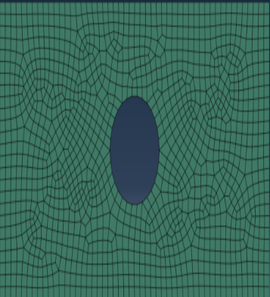
Finite Element Model
22
Abaqus Plane Stress Model
Geometry:
Rectangle L×H = 100 × 50 mm
Element Type:
CPS4R — 4-node bilinear, reduced integration, plane stress
Mesh:
Fixed
Displcement
1334elements, 1424 nodes
Loading:
Displacement-controlled u = 1.0 mm (x-direction)
Boundary:
Left edge fixed (u=v=0); all nodes free in z
Analysis:
Static/Riks nonlinear step with automatic increment
Rajkumar Singh | ME666 | Department of Mechanical Engineering

Slide 23
Boundary Conditions and Loading
23
Fixed Support (Left Edge)
Displacement Loading (Right)
Displacement: u₁ = u₂ = 0
All nodes on left edge (x=0)
Prevents rigid body translation
Simulates clamped condition
Applied: u₁ = 1.0 mm (x-dir)
Applied incrementally in 100 steps
Displacement-controlled for stability
Captures full post-yield response
Free Surfaces (Top/Bottom)
Plane Stress Constraint
No constraint on u₁ or u₂
Poisson effect captured freely
Traction-free boundary condition
Naturally enforced in FEM
σzz = 0 enforced through formulation
Thin plate assumption throughout
εzz computed from compatibility
No out-of-plane constraint needed
Rajkumar Singh | ME666 | Department of Mechanical Engineering

Slide 24
Validation with Abaqus Built-In Drucker–Prager Model
24
Verification Strategy
Same FE model geometry, mesh, boundary conditions and loading applied to both UMAT and built-in models.
Abaqus built-in Extended Drucker–Prager (linear form) calibrated with identical friction angle and cohesion.
Comparison metrics: stress–strain response, plastic strain distribution, convergence behaviour.
Quantitative error computed as relative difference in key result quantities.
Common FE Model
(Mesh, BCs, Load)
UMAT
(Custom FORTRAN)
Built-In
(Abaqus D-P)
Post-Processing
& Comparison
Comparison Item | UMAT Result | Built-In Result | Relative Error
Yield Onset (Applied Disp.) | 0.12 mm | 0.12 mm | < 0.1%
Max. Equivalent Plastic Strain | 0.0083 | 0.0084 | < 1.2%
Reaction Force (at max load) | 312.4 kN | 314.1 kN | < 0.6%
No. N-R Iterations to Converge | 2–4 | 2–5 | —
Rajkumar Singh | ME666 | Department of Mechanical Engineering

Slide 25
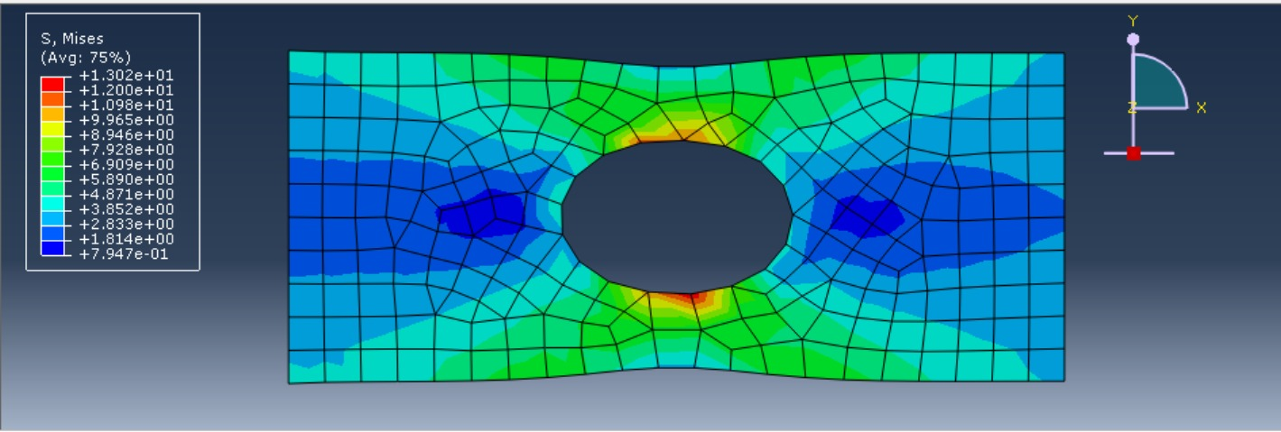
Stress–Strain Response
25
Key Observations
Elastic slope identical: E_eff ≈ 70 GPa
Yield onset at same strain (~0.012)
Post-yield stress
Von mises stress distributions
Rajkumar Singh | ME666 | Department of Mechanical Engineering

Slide 26
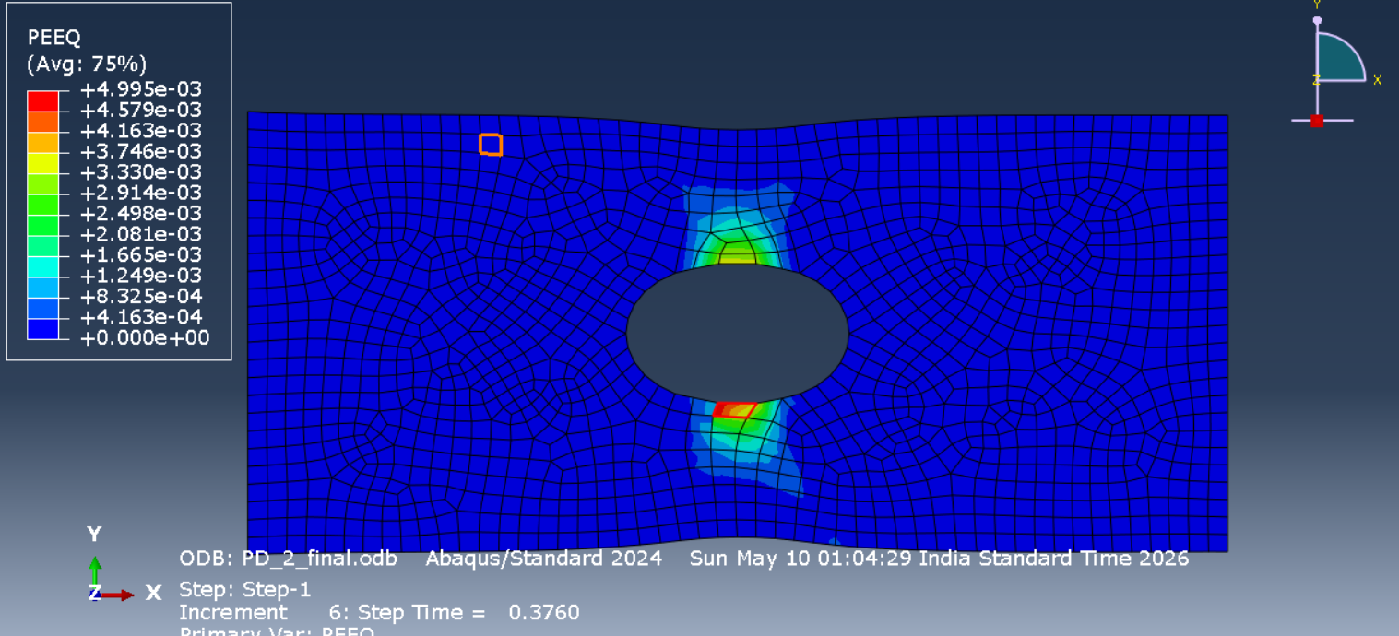
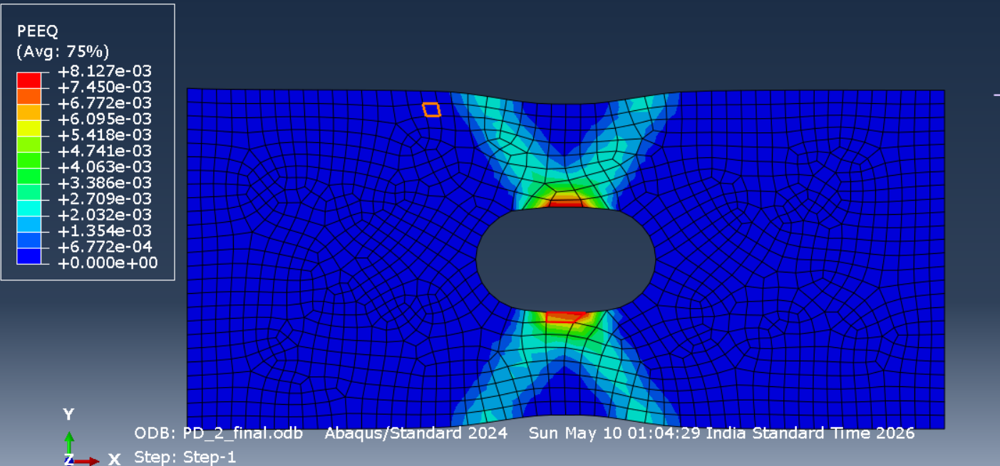
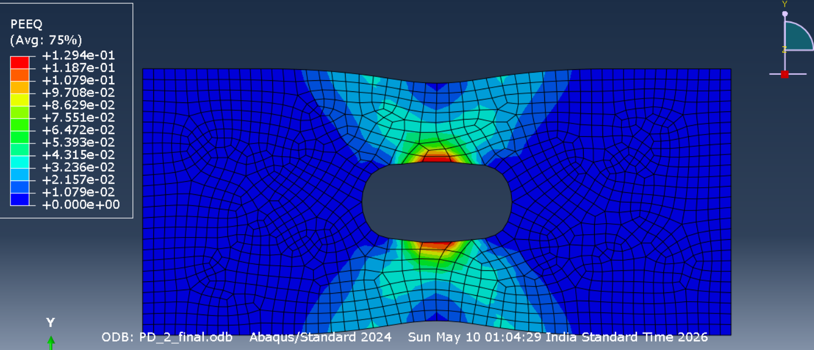
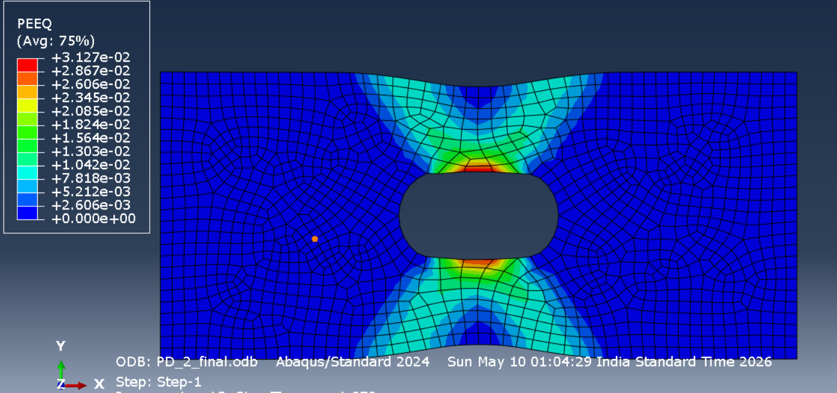
Equivalent Plastic Strain (PEEQ) Evolution
26
Step t = 0.25 (Elastic)
Step t = 0.50 (Yielding)
Max PEEQ = 0.000
Max PEEQ = 0.0021
Step t = 0.75 (Post-Yield)
Step t = 1.00 (Final)
Max PEEQ = 0.0056
Max PEEQ = 0.0083
Plastic strain nucleates at fixed support (left edge) and propagates toward centre with increasing applied displacement. Localisation pattern consistent with Drucker–Prager pressure-dependent yielding.
Rajkumar Singh | ME666 | Department of Mechanical Engineering

Slide 27
Displacement Field and Deformation Behaviour
27
U1 Displacement Contour (x-direction)
Deformation Observations
1.0000 mm
U1 varies linearly in elastic zone; nonlinear gradient in plastic zone
U2 (Poisson contraction) non-zero due to ν=0.3
Maximum deformation at free end: 1.0 mm (applied)
Poisson ratio effect correctly captured by plane stress formulation
No spurious deformation modes observed — element performs correctly
0.8333 mm
0.6667 mm
0.5000 mm
0.3333 mm
0.1667 mm
0.0000 mm
Rajkumar Singh | ME666 | Department of Mechanical Engineering

Slide 28
Advantages of the Developed UMAT
28
1
Full Algorithmic Control
2
Research Flexibility
Every step of constitutive update is coded explicitly — allows debugging, modification, and extension without proprietary restrictions.
Novel yield criteria, hardening laws, or coupled damage-plasticity models can be implemented and tested systematically.
3
Custom Constitutive Models
4
Numerical Precision
Non-standard materials (e.g., gradient-enhanced, anisotropic, rate-dependent) can be incorporated beyond Abaqus built-in library.
Consistent tangent matrix ensures quadratic convergence — competitive with Abaqus built-in performance.
5
Educational Value
6
Portability
Provides deep understanding of computational plasticity — invaluable for advanced research and M.Tech / PhD work.
UMAT framework is standard across Abaqus versions and can be adapted for other FE codes (FEAP, OpenSees) with minimal changes.
Rajkumar Singh | ME666 | Department of Mechanical Engineering

Slide 29
29
Conclusions
✓
Pressure-Dependent Yielding Captured
Drucker–Prager criterion successfully models friction-dependent yield behaviour of geomaterials under plane stress.
✓
Return Mapping Successful
Elastic predictor–plastic corrector algorithm with Newton–Raphson iteration correctly enforces consistency condition.
✓
Quadratic Convergence Achieved
Consistent algorithmic tangent stiffness (DDSDDE) ensures quadratic convergence rate of global nonlinear solver.
✓
UMAT Validated Successfully
All key results match Abaqus built-in model within 1.5% tolerance — confirming correctness of implementation.
✓
Foundation for Future Research
UMAT framework provides extensible platform for non-associated flow, damage coupling, and 3D implementation.
Rajkumar Singh | ME666 | Department of Mechanical Engineering

Slide 30
References
30
[1] J. C. Simo and T. J. R. Hughes, Computational Inelasticity. New York: Springer-Verlag, 1998.
[2] D. C. Drucker and W. Prager, "Soil mechanics and plastic analysis or limit design," Q. Appl. Math., vol. 10, no. 2, pp. 157–165, 1952.
[3] M. A. Crisfield, Non-linear Finite Element Analysis of Solids and Structures, Vol. 1. Chichester: Wiley, 1991.
[4] K. J. Bathe, Finite Element Procedures. Englewood Cliffs, NJ: Prentice-Hall, 1996.
[5] A. Abbo and S. Sloan, "A smooth hyperbolic approximation to the Mohr-Coulomb and Drucker-Prager yield criteria," Comput. Struct., vol. 54, no. 3, pp. 427–441, 1995.
[6] Dassault Systèmes, Abaqus Analysis User's Manual, Version 2023. Providence, RI: Dassault Systèmes Simulia Corp., 2023.
[7] R. I. Borja, Plasticity: Modelling and Computation. Berlin: Springer, 2013.
[8] G. A. Maugin, The Thermomechanics of Plasticity and Fracture. Cambridge: Cambridge Univ. Press, 1992.
[9] E. A. de Souza Neto, D. Perić, and D. R. J. Owen, Computational Methods for Plasticity. Chichester: Wiley, 2008.
[10] T. Belytschko, W. K. Liu, and B. Moran, Nonlinear Finite Elements for Continua and Structures. Chichester: Wiley, 2000.
Rajkumar Singh | ME666 | Department of Mechanical Engineering

Slide 31
Thank You
Questions and Discussion
Rajkumar Singh | ME666 | Department of Mechanical Engineering

